Slide 1
Widening the Use of Electronic Healthcare Data for Research
Isaac “Zak” Kohane, MD, PhD

Slide 2
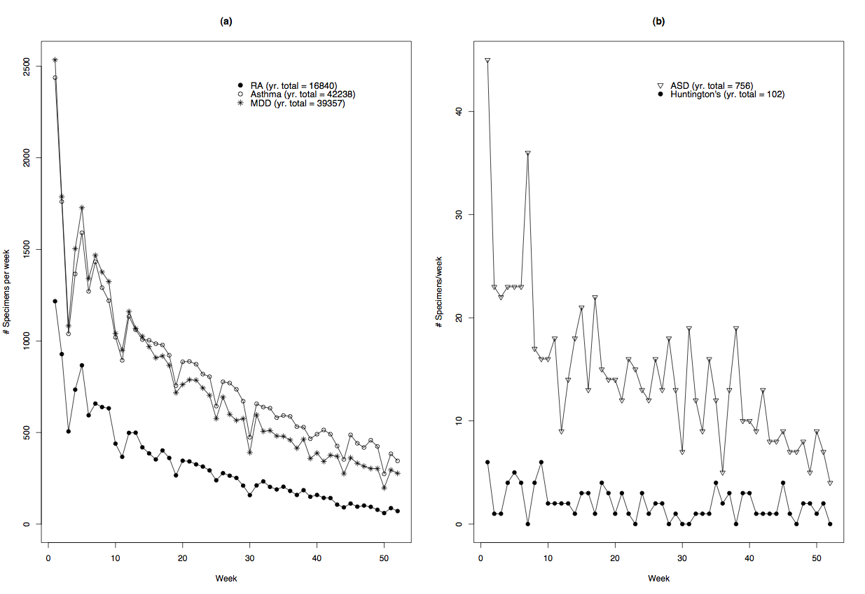
Accrual Rates

Slide 3
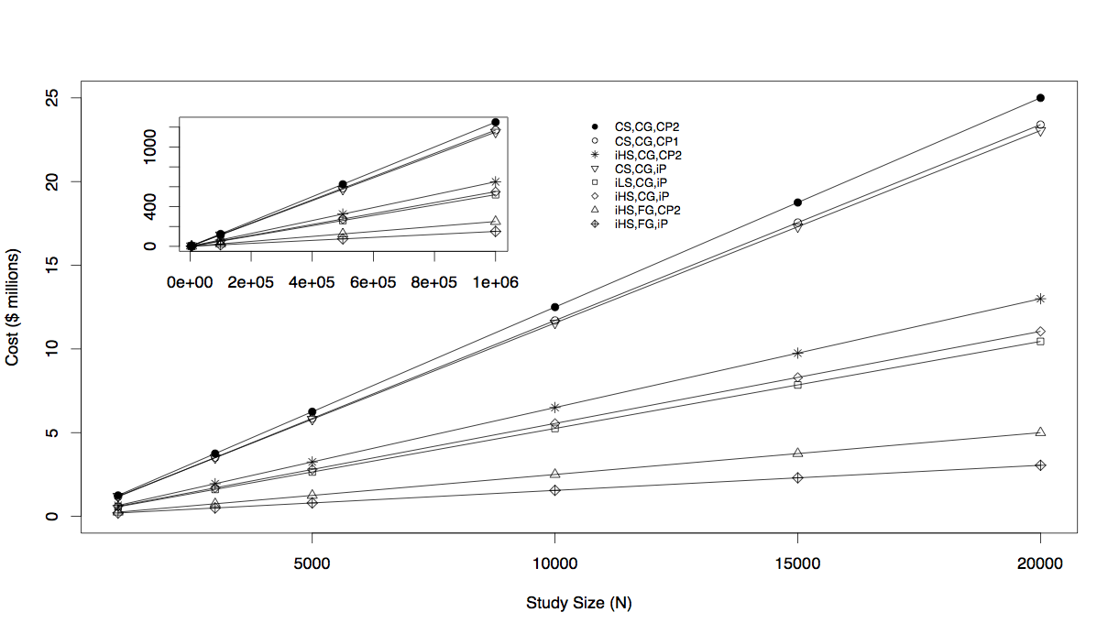
Costs
Murphy et al. Genome Research 2009

Slide 4
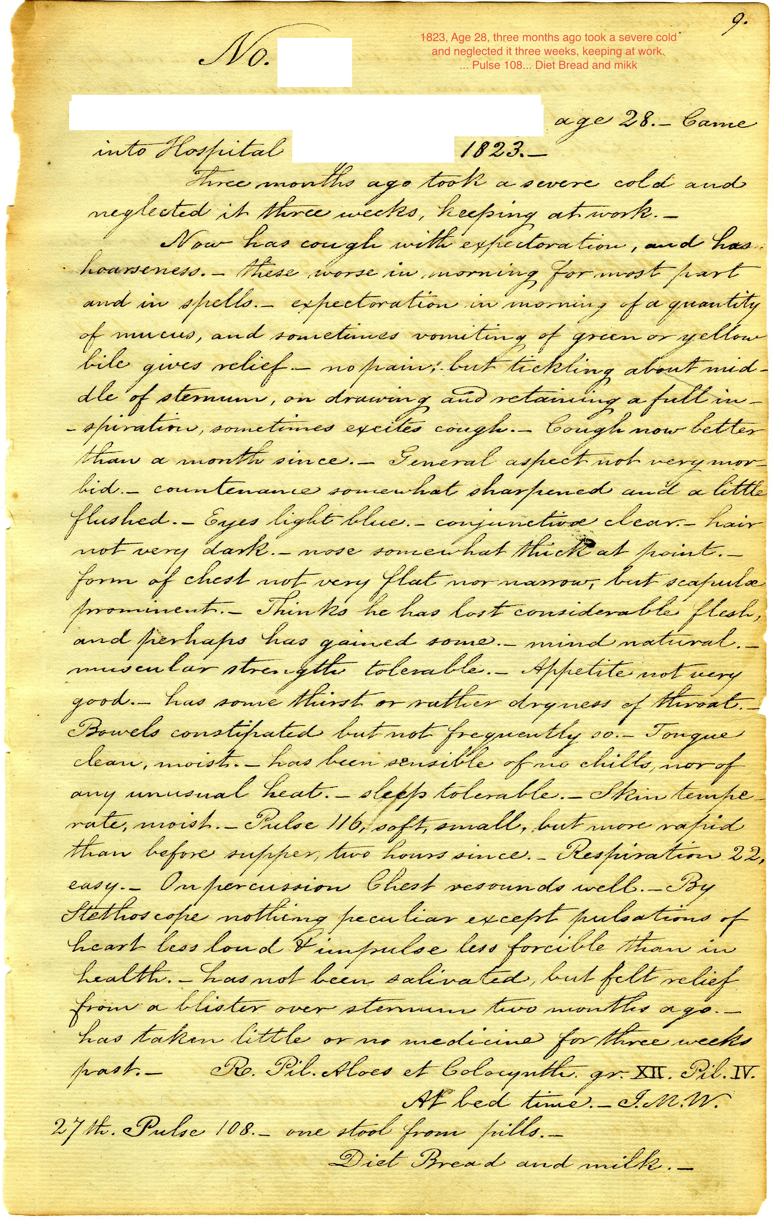
MGH Casebooks
1823, 23 year old, URI with productive cough, “neglected” x 3 weeks

Slide 5
Past Medical Records for Research of Past Medicine
Chris Crenner (faculty at University of Kansas Medical Center)
Used MGH medical and surgical casebooks as part of a study on race and medical care, 1870-1900
Loren Broc (graduate student at the University of Rochester)
Consulted Worcester Lunatic Asylum case records, 1833-1900, for a study of treatment of religious insanity

Slide 6
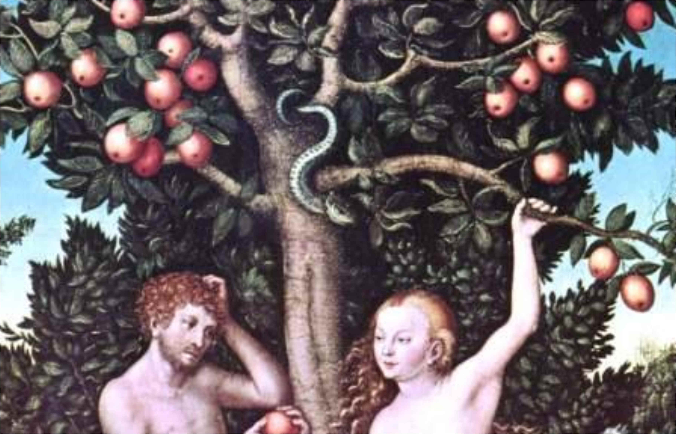

Slide 7
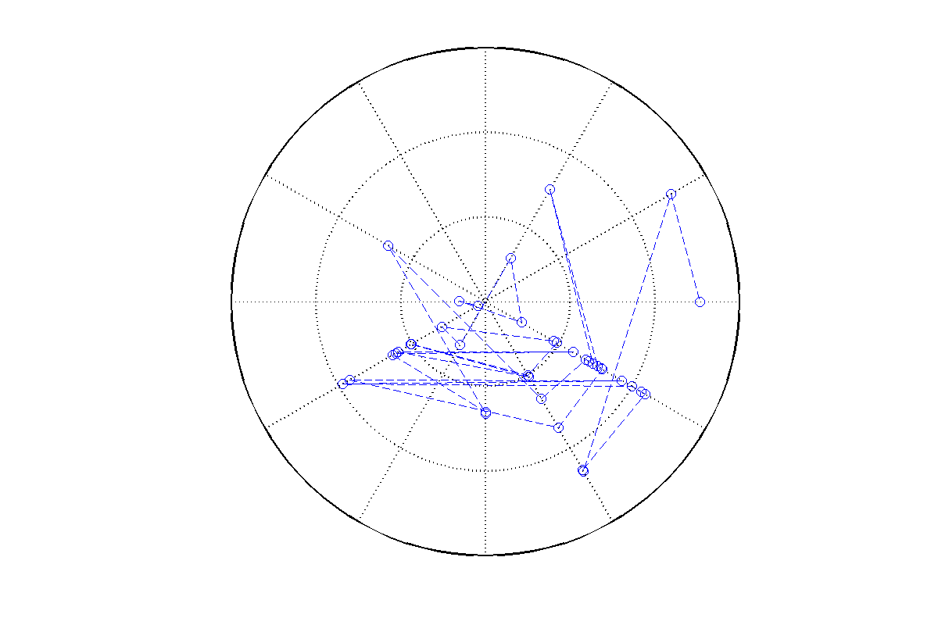
Reis, et al., BMJ 2009
EYE
DENTAL
PSYCH
FEVER/VIRAL
URINARY
RESP
ASSAULT
GASTRO
INJURY
E.N.T.
PAIN
Jane Q. Doe
ED Profile
June,1992 – Feb,1999
DERM
INJURY RISK: HIGH

Slide 8
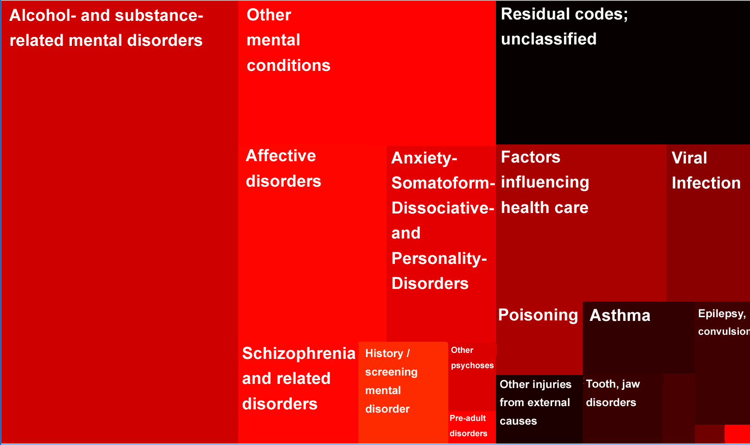
Male
Reis, et al.BMJ 2009

Slide 9
Personalizing Medicine Through Physician Behavior
Griffin Weber

Slide 10
Personalized By Population
Predicting length of stay according to “normality” of labs in first day: > 75% accuracy
Griffin Weber

Slide 11
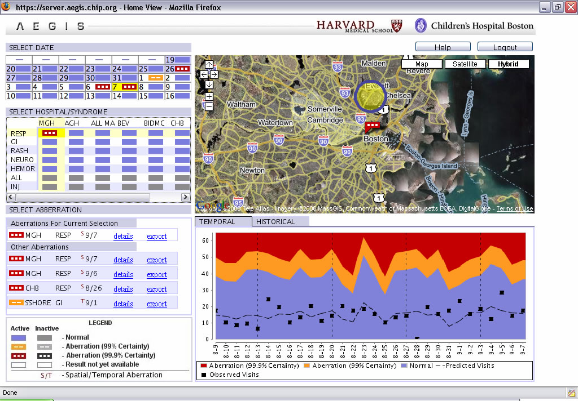

Slide 12
Age differences
Pneumonia/ Influenza Mortality (CDC)
Influenza like illness
(CDC)
Adult ED
Pediatric ED
Stat Med 2005

Slide 13
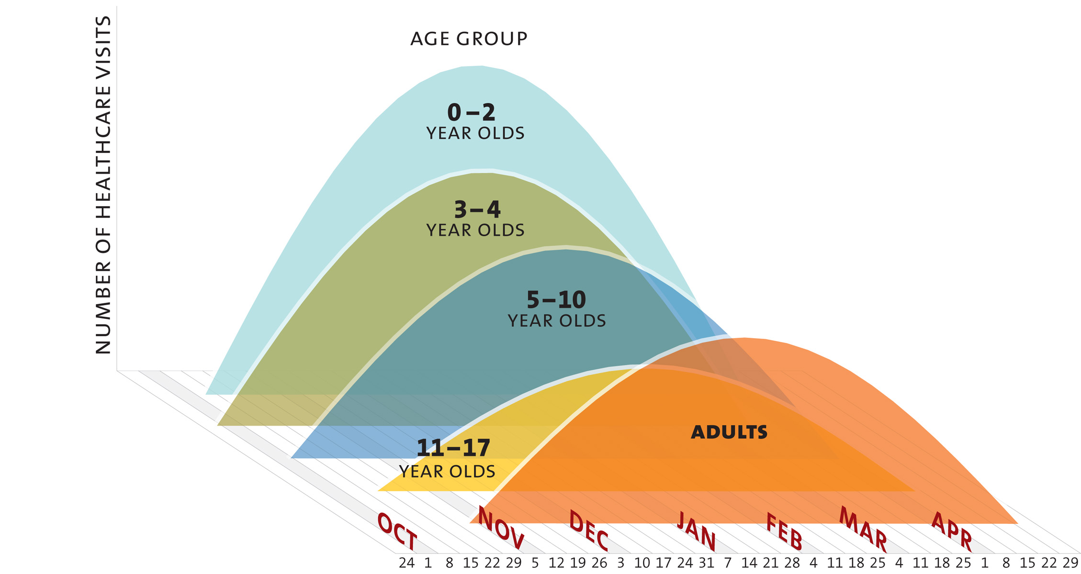
Defining pediatric targets
Am J Epidemiol 2005

Slide 14
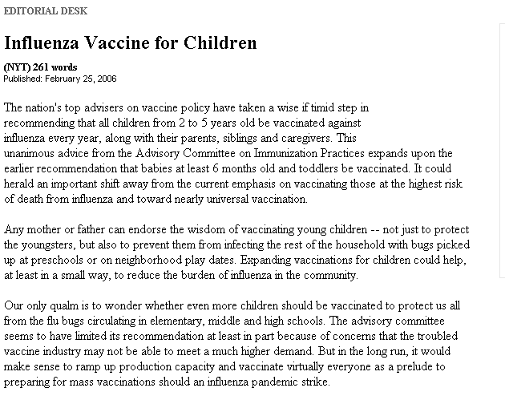

Slide 15
2008

Slide 16
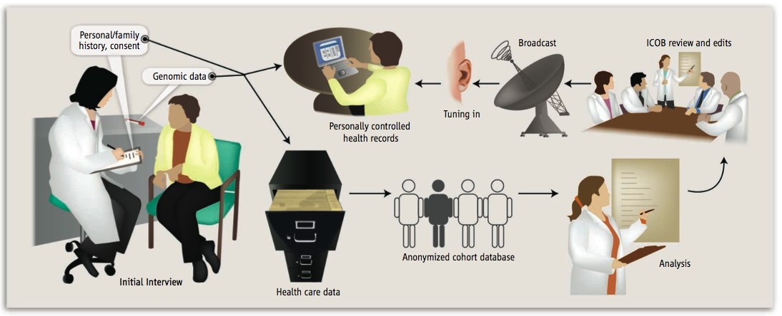
EHR and PHR as Research Vehicles
Kohane et al,
Science, 2007
Science, May 11th 2007

Slide 17
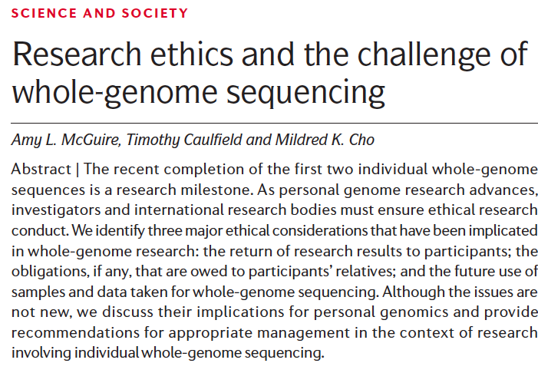
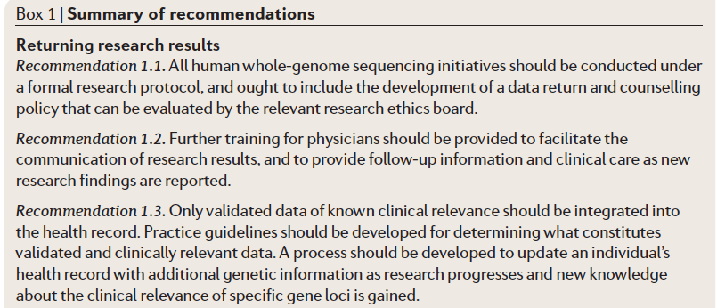

Slide 18
Summary
We do not need to wait to perform important and scaleable and cost effective research
Research utility of EHR could well lead clinical use.
EHR research CAN help transcend institutional barriers.
EHR’s are not only institutional
Can blur lines between research and care
May determine new loci of control and research excellence

