Slide 1
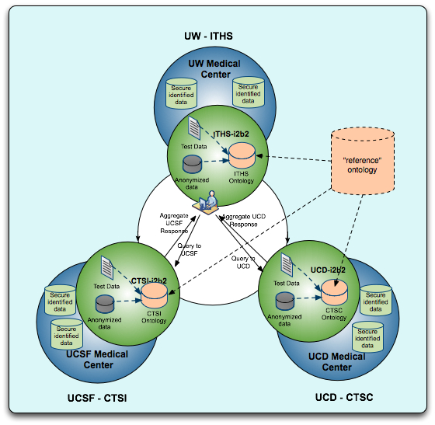
i2b2 CICTR Phase 3: Able to query multi-institutional anonymized PHI data
5+ million anonymized patient records across UW, UCSF and UCD.
up to 5 year retrospective at UCSF, UCD, 3 years at UW
Domain
Diabetes
Cardiovascular disease
Driving use cases
power calculations for cohort recruiting
Prep to research aggregate data studies
Intended users:
Clinical/translational PI’s
Study recruiters
Public Health researchers

Slide 2
Four parallel processes
Technical - IT/development/implementation/testing
Governance - Data Use Agreements/IRB institutional alignment
Ontology - Terminologies/semantic alignment
Evaluation - Process, outcomes and usability evaluation

Slide 3
Site ecosystems
Compatible server architectures/different DB environments architecture environments
“Identical” I2b2 environments
Common ETL and anonymization processes
Common development environments
Common knowledge environment
Broadly similar governance process

Slide 4
Human resources needed
Formal (e.g. – paid)
Informaticians
ETL analysts
Terminologists
Software architects/Developers
Usability/Evaluation researchers
Informatics/Information science students
IT staff
Informal (e.g. – priceless)
Support of project at highest institutional and regulatory levels - CIO/CTO
(new!) clinicians/clinical researchers

Slide 5
I2b2 CICTR
Available and anticipated data elements
Demographics | Diagnoses | Medications | Laboratory
Age | Date of diagnoses | Date of encounter | Date of lab
Gender | ICD-9 numeric codes | Medication name (generic/brand) | Lab values
Race/Ethnicity | iCD-9 supplemental classifications influencing health status | Dose form
Geocode (3 digit zip prefix) | ICD-9 supplemental classification of external causes of injury and poisoning
Vital status
Marital status
Language (tbd)
Religion (tbd)

