Slide 1
I2b2 AUG
“i2b2 in the South Carolina Integrated Platform
for Research - SCIPR”
Dr. Iain Sanderson,
CMIO, Health Sciences South Carolina,
Director, Biomedical Informatics,
South Carolina Clinical and Translational Science Institute
Dr. Jihad Obeid,
Associate Director, Biomedical Informatics,
South Carolina Clinical and Translational Science Institute

Slide 2
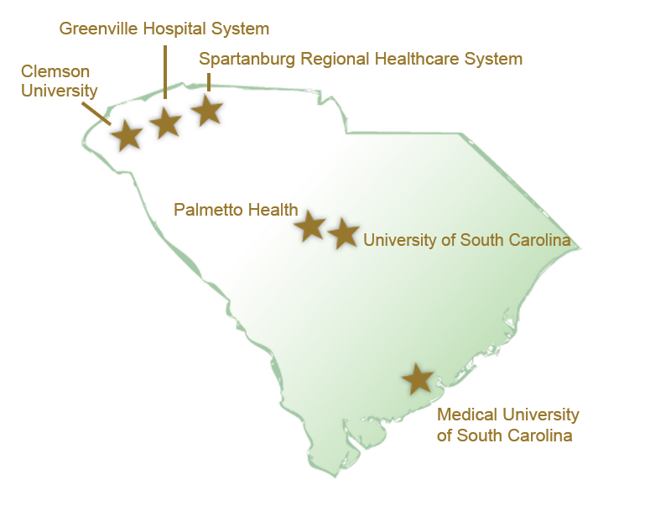
Informatics Initiatives in South Carolina
Health Sciences South Carolina ( HSSC)
  The Duke Endowment
  “South Carolina Health Data Portal”
  South Carolina Integrated Platform for Research - SCIPR
Achievements:
South Carolina Light Rail
ClickCommerce eIRB
Collexis Expert Profiling
South Carolina Health Information Exchange (SCHIEx)
… and MUSC’s recent CTSA

Slide 3
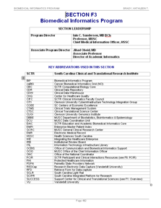
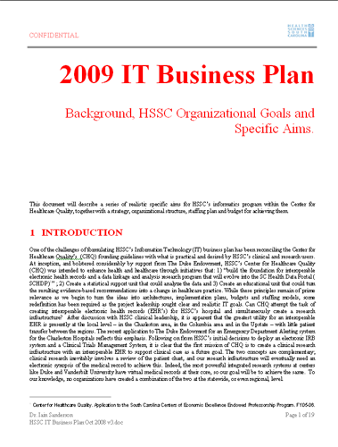
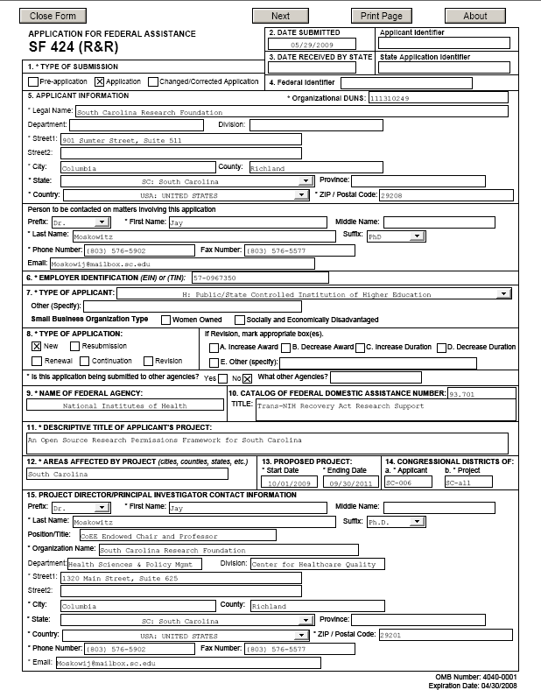

Alignment of Informatics Initiatives
CTSA
Biomedical
Informatics
HSSC’s
IT
Business
Plan
GO
Grant
Specific Aims:
Provide a catalog of generic IT services
To support Translational Research
In SC.
Specific Aims:
Build an integrated
Information system to
Impact wellness through translational research in SC. ( Called SCIPR)
Specific Aims:
Create a Research Permissions
Management System for SC.
Statewide support for translational research through Informatics Solutions

Slide 4
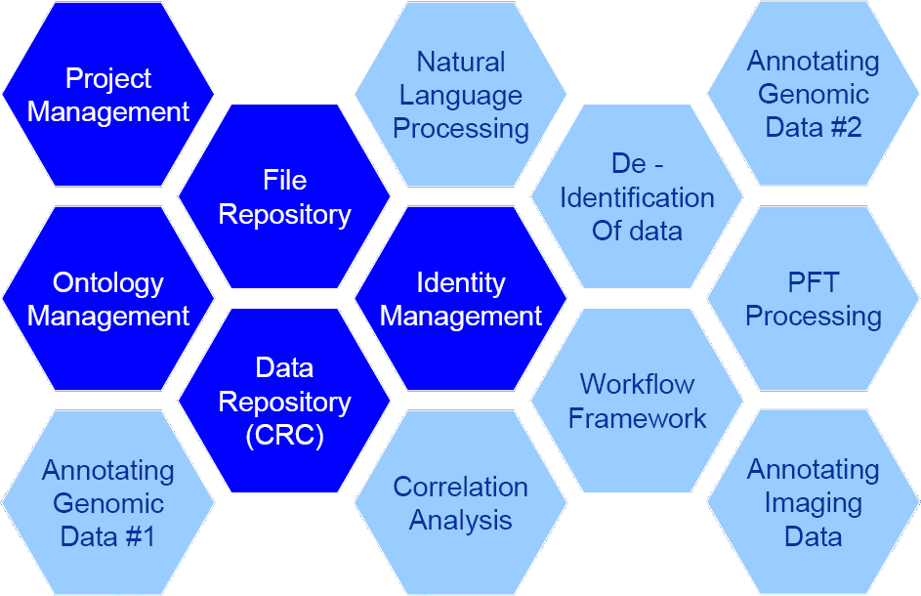
The South Carolina Integrated Platform for Research ( SCIPR) and i2b2
SCIPR’s goal is an integrated collection of research applications
  Built around an Enterprise Master Patient Index (EMPI), Operational Data Store(ODS) and Clinical Research Data Warehouse ( CRDW) for 6 HSSC institutions
  Consolidated, statewide eIRB
  Integrated clinical trials management system
  Expert profiling
  Portal infrastructure for “one stop shop”, messaging and secondary use of data
  Provide analytical services, real-time clinical decision support and possibly data warehousing services back to the originating institutions
For the CRDW we selected i2b2
  Implementation services and Data Trust provided by Recombinant Data Corp.
For Messaging, EMPI and Portal services we selected Sun’s Java Composite Application Suite (JavaCaps)
  Implementation services provided by Recombinant through Sun partnership
Notes:
Added:
clinical trials listing (interactive for the public), website tools (bullet 4)
Data warehouse research requests (we’ve done a few), + consults (bullet 5)
“state-wide” (last bullet)

Slide 5
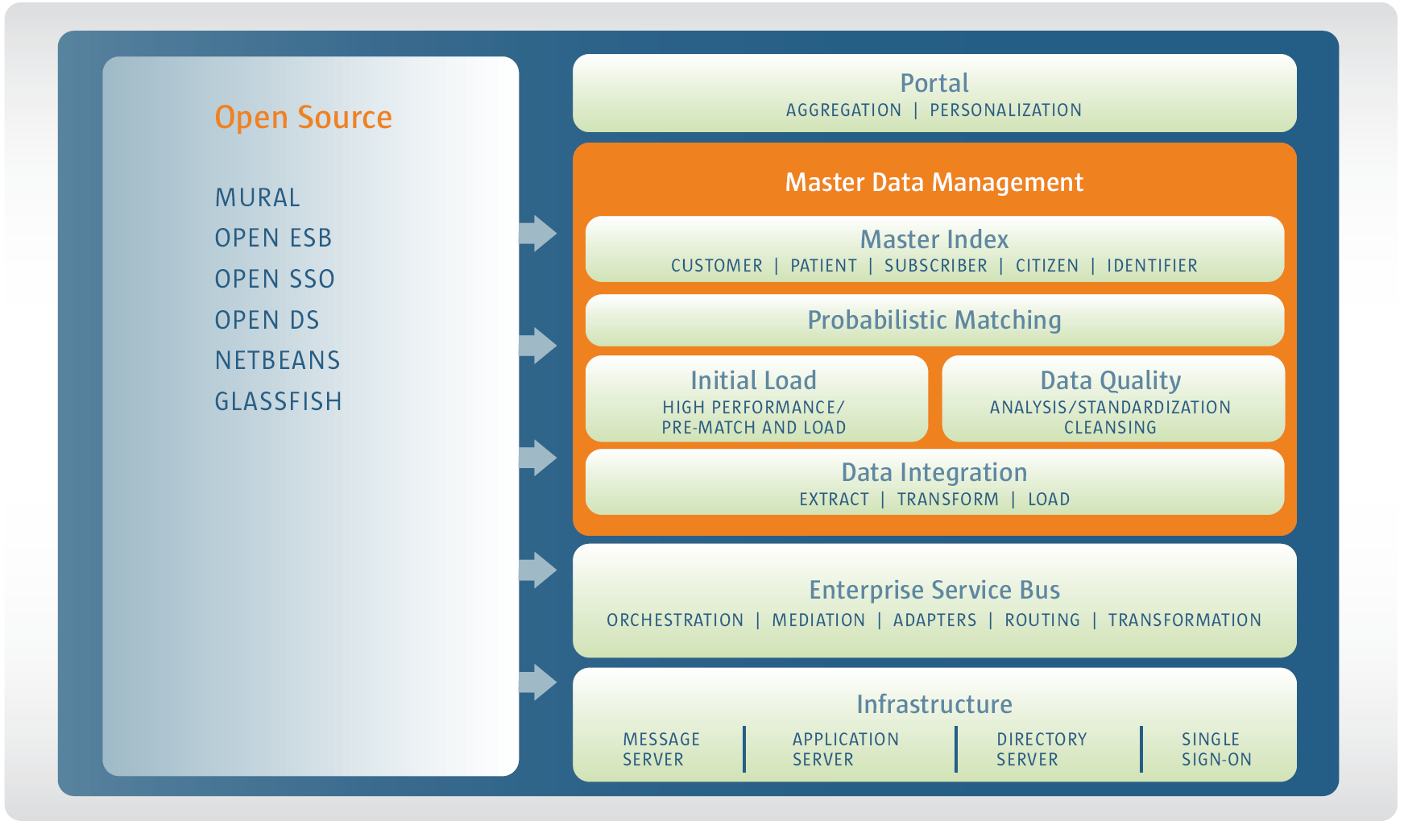


JavaCaps. Open source hooks and ready for heavy lifting – eGate/ EMPI
LifeRay
Portal
Enterprise
Master
Patient
Index
HL7
messaging.
ETL.

Slide 6
Recombinant will create their data Trust using JavaCAPS
Data Sources
HSSC
CDW
Clinical
Clinical notes
Diagnoses
Procedures
Medications
Demographics
Provider master
Code sets
Locations
Claims
Billing
Pathology
Radiology
Genomics
Specialty databases
Research databases
CTMS
Master
Data
Taxonomy
Data Staging and
Integration
Java CAPS
ETL
Measures
Financials
Audit Logs
Java CAPS
(project Mural)
EMPI
Laboratory
Research
Java CAPS (OpenESB) Service Bus
Greenville
MUSC
Palmetto
Spartanburg
USC

Slide 7
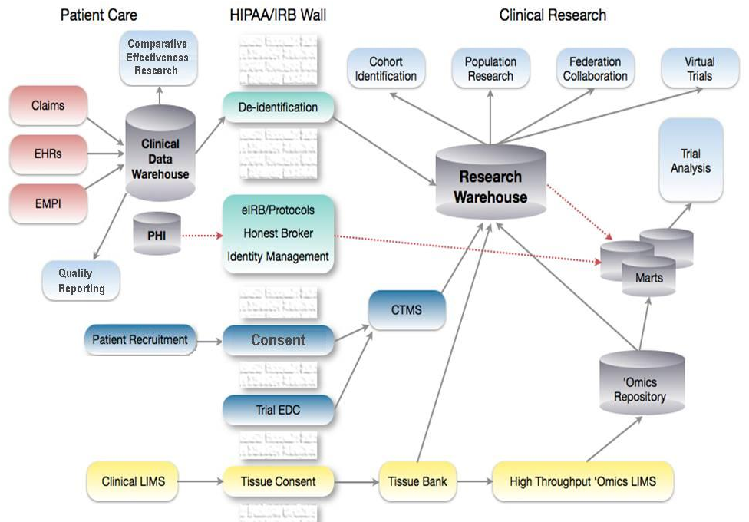


Clinical Research Informatics Ecosystem
Data Trust

Slide 8
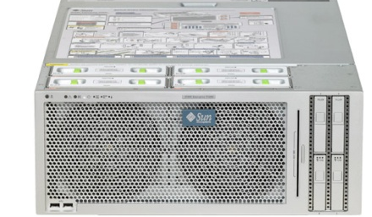

We have started building the systems…
Hosting
Cores
Project Management and Support Cores
Working on:
-Data sharing
agreements
-Hosting architecture
-training staff ( JavaCaps)
-building CTSA infrastructure
At MUSC
Informatics
Cores

Slide 9

GO Grant Aims– A Research Permissions Framework for SC
Leverages CTSA, HSSC, Duke and industry partnerships
Analyze business processes of current Consent Management across SC
Create a research permissions ontology (“logical framework”)
Examine ELSI issues and guide project - Duke
Change the way research permissions are collected across HSSC using a standards-based data collection method ( CDISC’s RFD)
Provide permissions feedback to consumers via a portal
Publish the code as open source to the research community within the i2b2 project
Focus of Projects is currently the Privacy Authorizations Framework for development work on our data warehouse. Eventually a DURSA is anticipated.
Notes:
(not sure if needed – can highlight GO grant in the initiative alignment slide)

Slide 10
Research Permissions Concept in i2b2

