Slide 1
From Bedside to Bench and Back
Isaac “Zak” Kohane, MD, PhD

Slide 2
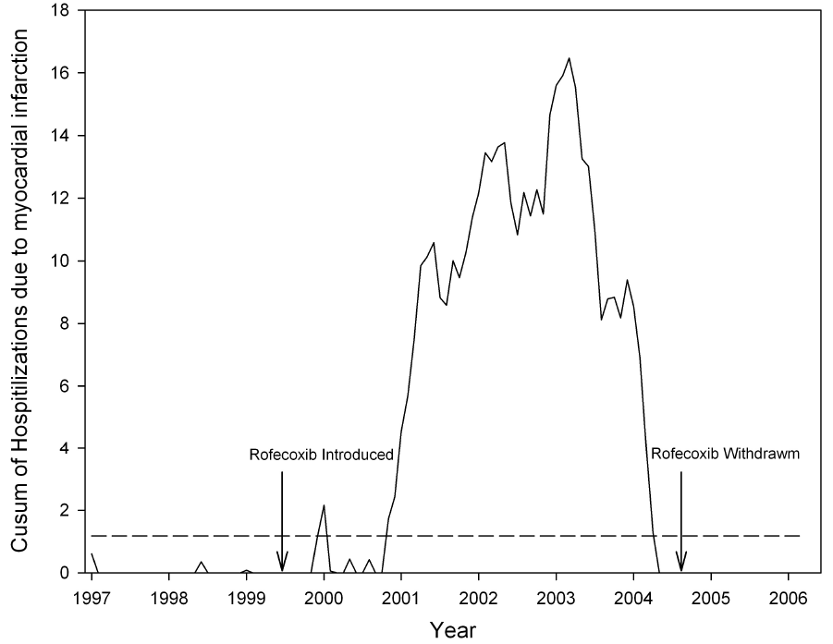
First signal:
1 year after Celecoxib
8 months after Rofecoxib

Slide 3
Oral Hypoglycemic Agents
Notes:
THIS DIAGRAM OUT OF OUR DIABETES CARE ARTICLE SHOWS THAT ROSIGLITAZONE = AVANDIA HAS INCREASED RELATIVE RISK EVEN COMPARED TO DRUGS IN THE SAME CLASS (I.E. PIOGLITAZONE)
OTHER I2B2 FOCI: INCORPORATING MULTIPLE “CELLS” CONTRIBUTED BY USERS (E.G. RECRUITMENT FOR TRIALS, CONSENT, INTERFACE TO BIOREPOSITORIES)
OTHER I2B2 FOCI: TEMPORAL REASONING IN QUERIES AND IN NLP, FASTER NLP (IN TUNING IT FOR A PARTICULAR QUESTION).
OTHER I2B2 FOCI: INCORPORATING GENOMIC (NEXTGEN) DATA INTO THE DATA MODEL AND QUERY STRUCTURES.

Slide 4
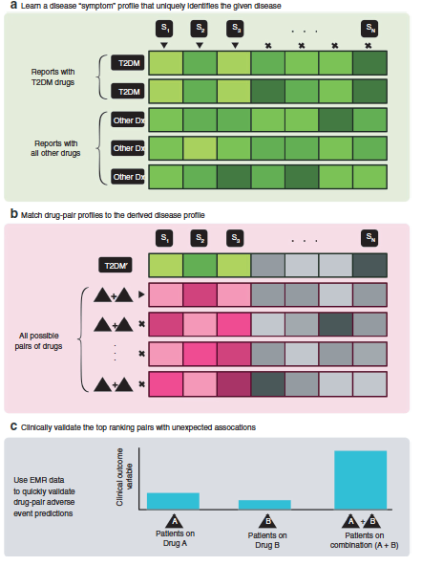
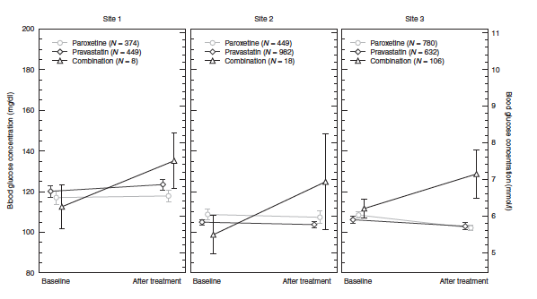
Without strong priors

Slide 5
Major Modes of EHR Driven Genomic Research (EDGR)
EHR
EHR

Slide 6
EDGR Advantages
Timeliness
Clinical Relevance
Underserved populations
Controls
Co-morbidity recognition (e.g. PheWAS)

Slide 7
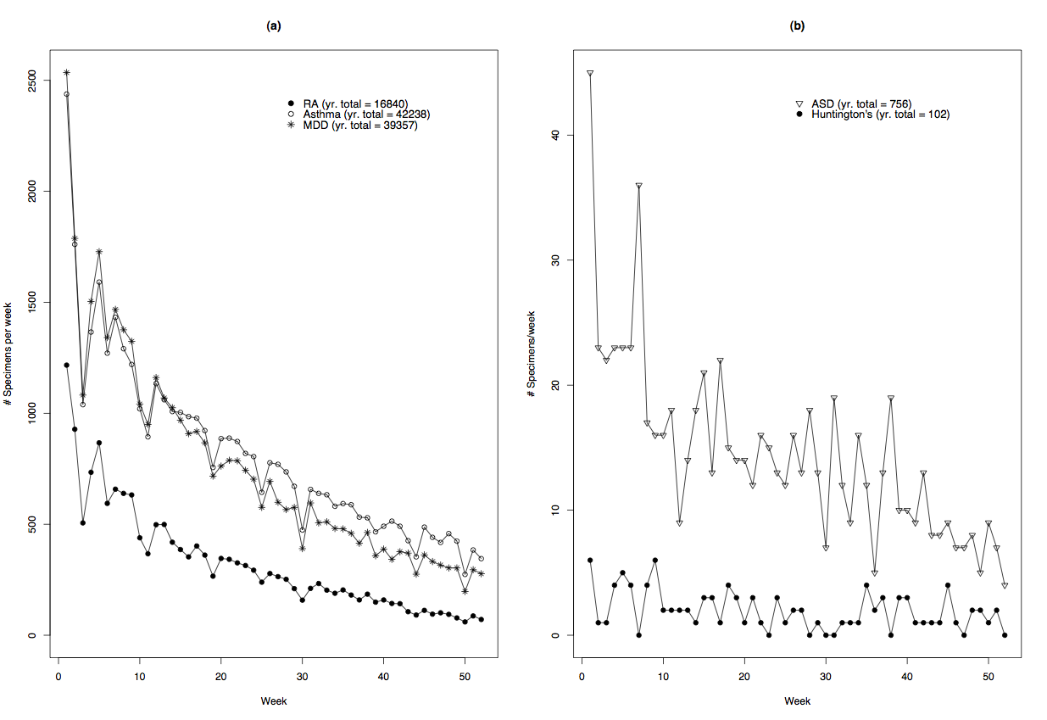
Accrual Rates
Murphy et al Genome Research, 2009

Slide 8
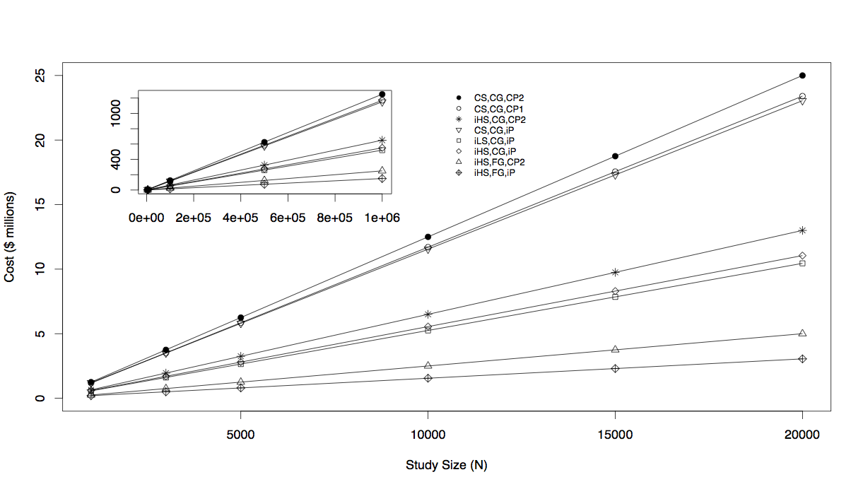
Costs
Murphy et al Genome Research, 2009

Slide 9
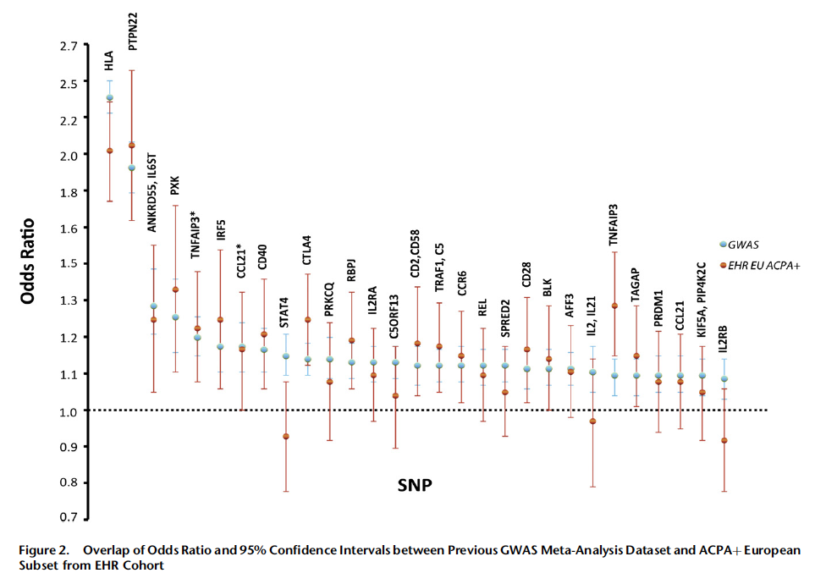
But it works…
Kurreeman, AJHG 2011

Slide 10
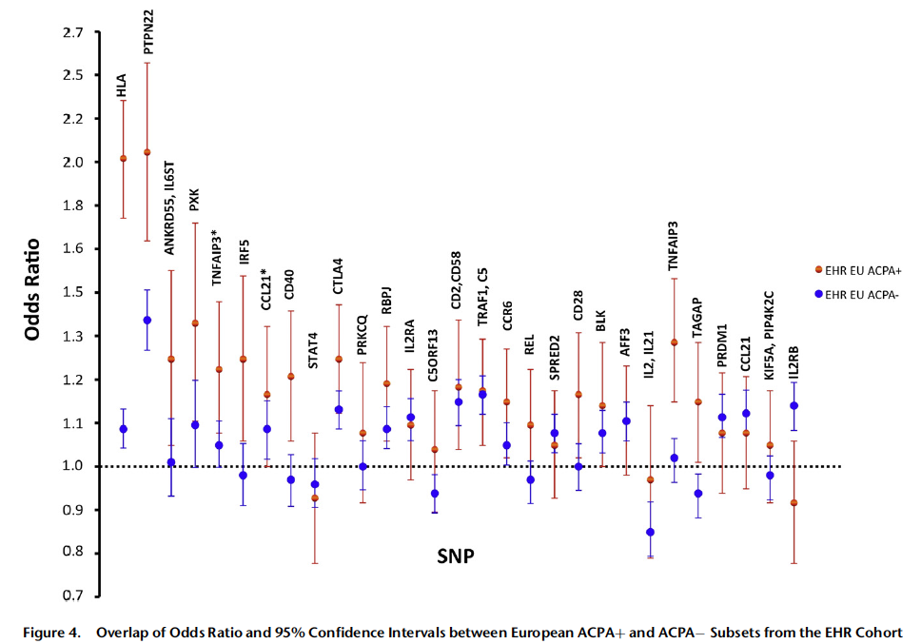
Kurreeman, AJHG 2011

Slide 11
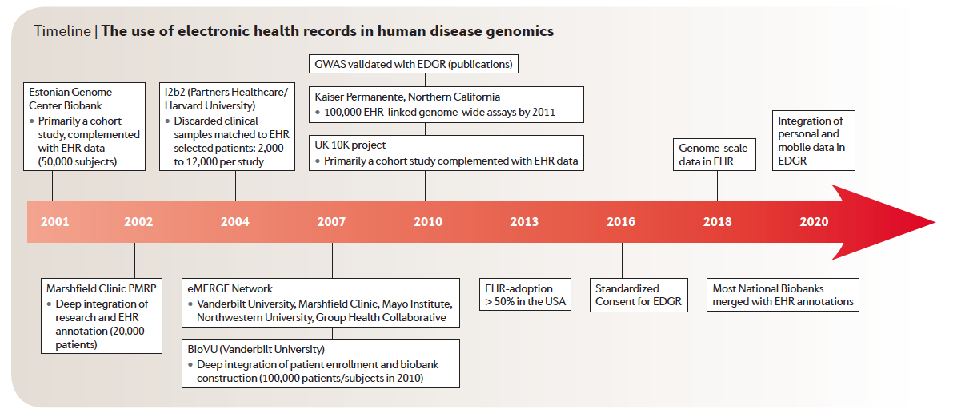
Timeline

Slide 12
EDGR Challenges
Consent (None/Opt-in/Opt-Out)
Cost of EHRs
Quality of EHR data
Lack of Family History codification
Lack of EHR standardization
Cultural gulf between clinical informatics and bioinformatics.
  Translational Bioinformatics

Slide 13
Application to a common pediatric disease
With an understudied epidemiology

Slide 14
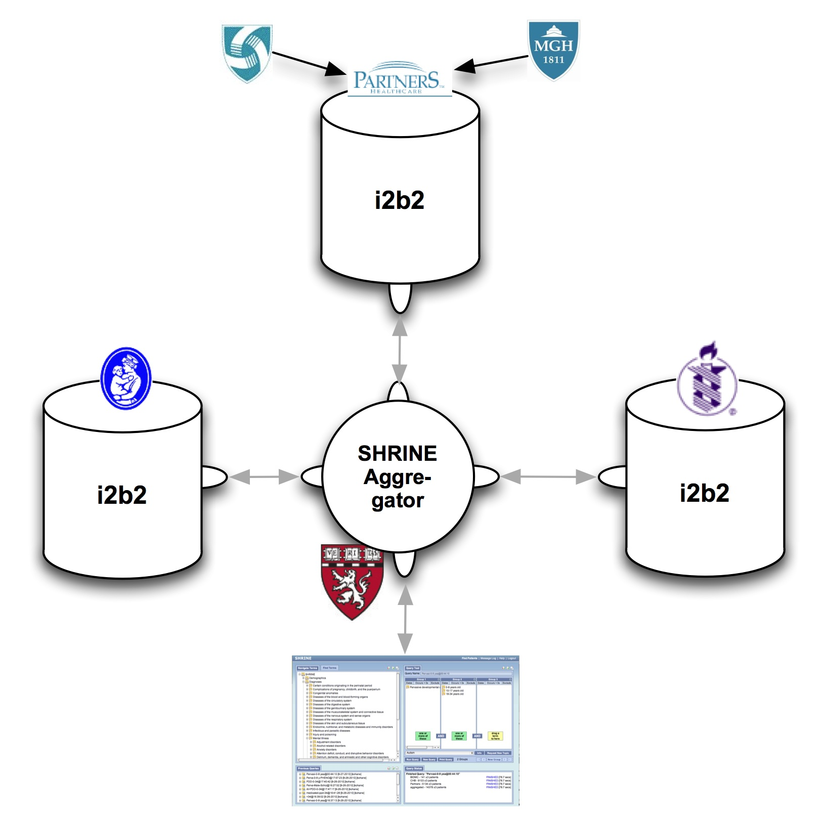
Aggregating across 4 hospitals, 3 i2b2 instances

Slide 15
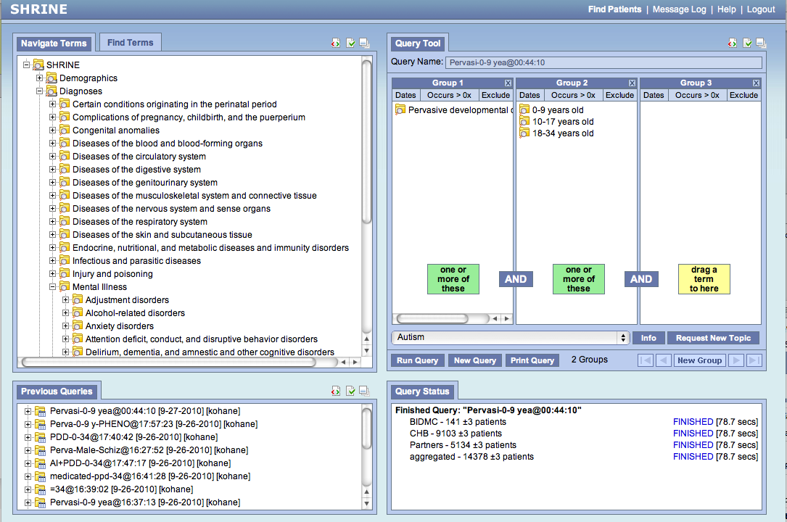
Notes:
SHRINE: distributed multiinstitutional query across hospitals. Working at Harvard (!) and NW

Slide 16
Co-morbidities in autism vs. hospital population

Slide 17
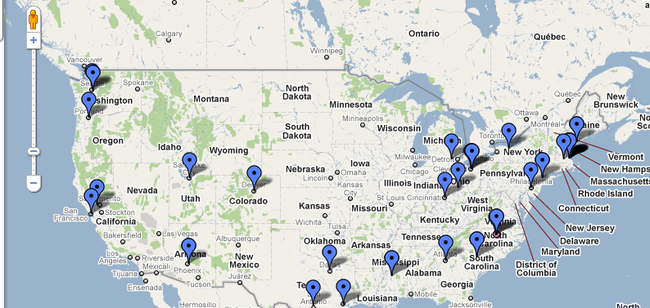
2012
SHRINE conf 6/29
Notes:
Open source toolkit adopted by over 50 academic health centers in the USA and 6 internationally. INCLUDES OVER ½ THE CTSA AWARDEES

Slide 18
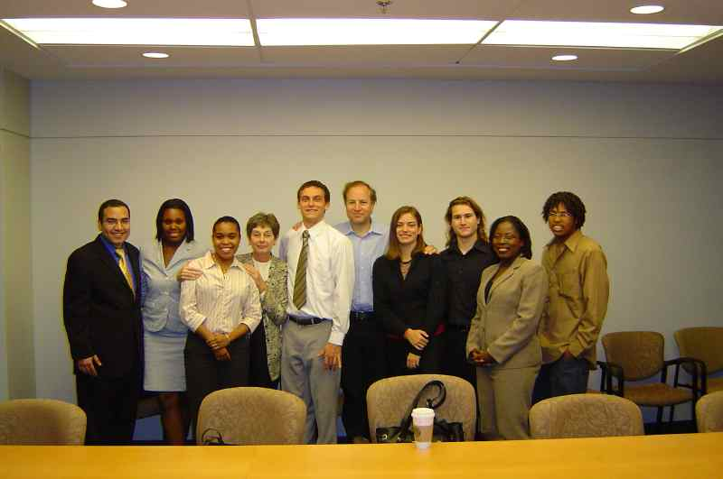
Thank you

Slide 19
Challenge: Efficiently Reach Large N for Population studies
High throughput genotyping
High throughput phenotyping
High throughput sample acquisition
DHHS Secretary’s Advisory Committee on Genetics, Health, and Society (SACGHS) argues for the health value of a 500,000 to 1M subject study. Estimated cost: $3,000,000,000

Slide 20
Who?
Health Care Utilization
(Hospitalization, ED Visits)
Genes
+
Clinical Factors

Slide 21
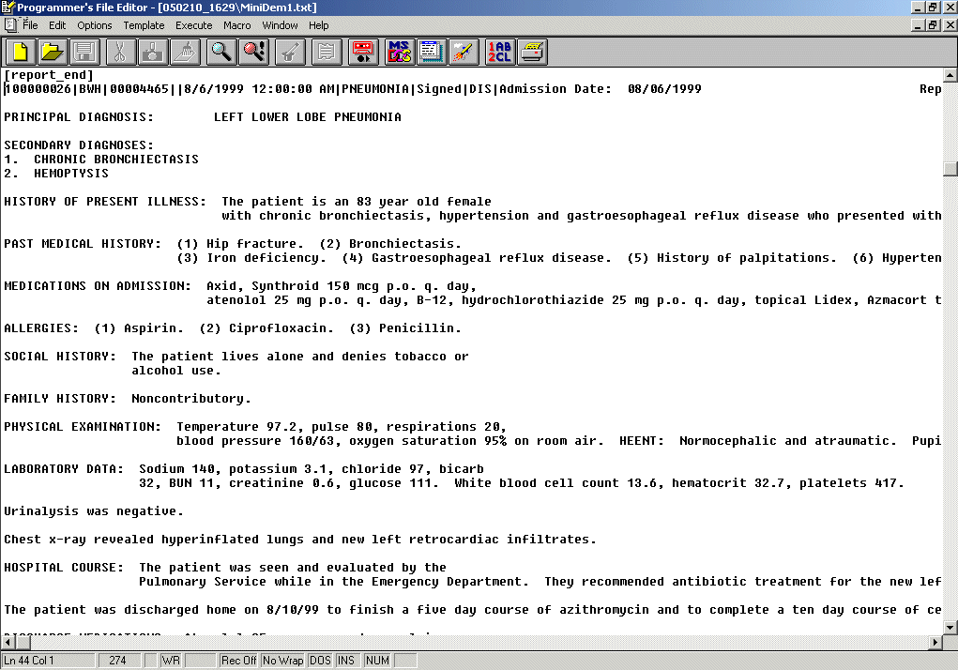
NLP (and comedy) is not pretty
SOCIAL HISTORY: The patient is married with four grown daughters,
uses tobacco, has wine with dinner.
Smoker
SOCIAL HISTORY: The patient is a nonsmoker. No alcohol.
Non-Smoker
SOCIAL HISTORY: Negative for tobacco, alcohol, and IV drug abuse.
BRIEF RESUME OF HOSPITAL COURSE:
63 yo woman with COPD, 50 pack-yr tobacco (quit 3 wks ago), spinal stenosis, ...
Past Smoker
SOCIAL HISTORY: The patient lives in rehab, married. Unclear smoking history
from the admission note…
???
HOSPITAL COURSE: ... It was recommended that she receive …We also added Lactinax, oral form of Lactobacillus acidophilus to attempt a repopulation of her gut.
Hard to pick
Hard to pick
SH: widow,lives alone,2 children,no tob/alcohol.

Slide 22
Crimson: Core Functions
Matched
Anonymous
ID
Mined Phenotypes
Clinical discard
Richly annotated biospecimens

Slide 23
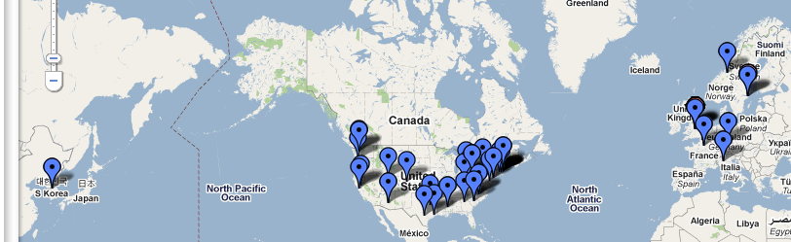
Free and Open Source Translational Toolkit: Implementations
Project
Management
Natural
Language
Processing
Visual Term
Mapping
File
Repository
De -
Identification
Of data
Ontology
Management
Identity
Management
Annotating
Genomic
Data
Data
Repository
(CRC)
Workflow
Framework
Data ^{Queries}
Data
Visualization
Correlation
Analysis
Notes:
Open source toolkit adopted by over 50 academic health centers in the USA and 6 internationally. INCLUDES OVER ½ THE CTSA AWARDEES

Slide 24
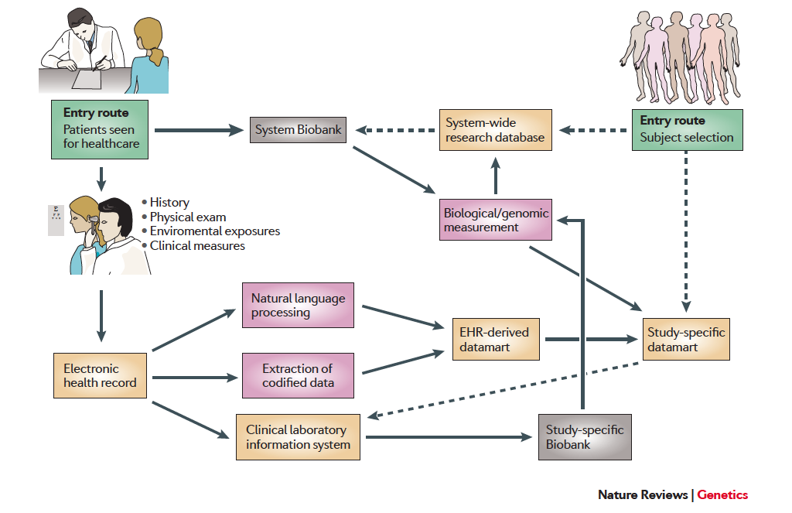
Major Modes (II)

